Slide 1
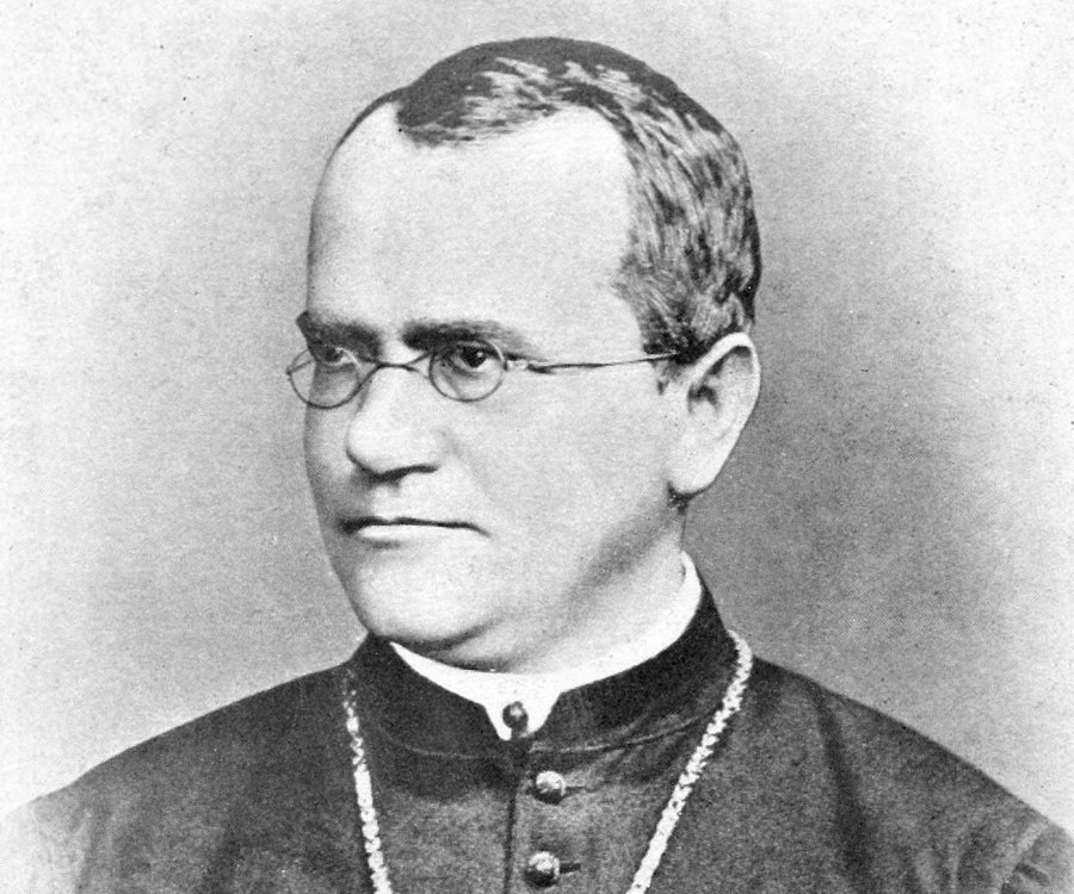
MendelIHT.jl: Sparse Generalized Linear Models for High Dimensional (GWAS) Data
Benjamin Chu
7/25/2019
UCLA
Package: github.com/biona001/MendelIHT.jl
Slides: github.com/biona001/public-talks

Slide 2
OpenMendel: Statistical Genetics Research
Visit us: github.com/OpenMendel
Human Genetics (2019): https://link.springer.com/article/10.1007/s00439-019-02001-z

Slide 3
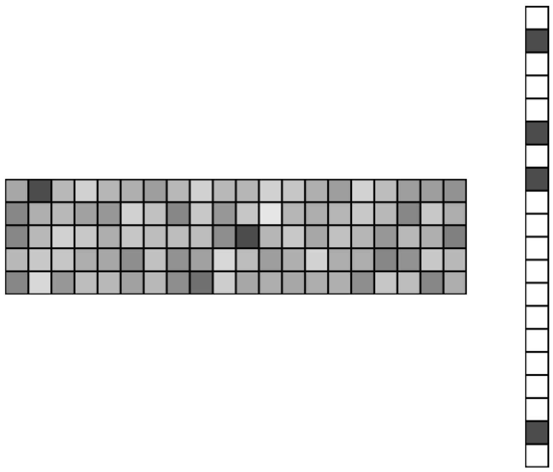
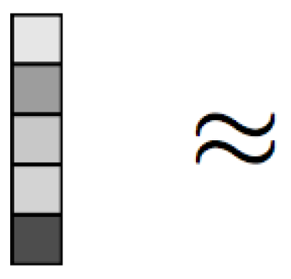
Generalized Linear Models Regression
Given dense , find sparse such that:
(link function applied elementwise)
(response)
(measurements)
(statistical model)
Figure: https://www.cs.cmu.edu/~ggordon/10725-F12/scribes/10725_Lecture2.pdf

Slide 4
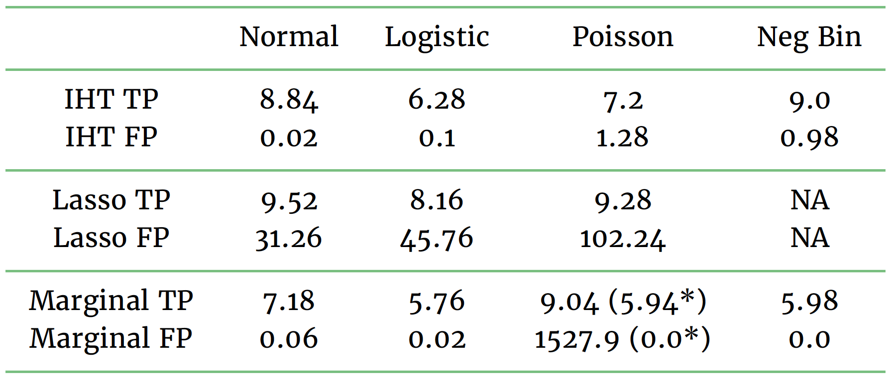
Generality & Existing Methods
Examples: Normal, Poisson, multinomial, gamma, negative binomial, inverse Gaussian, Cox…
Solutions: iterative hard-thresholding (MendelIHT.jl), lasso, marginal regression, elastic net, MCP, stepwise regression…
TP = true positives (higher means good)
FP = false positives (lower means good)
See our paper: https://www.biorxiv.org/content/10.1101/697755v1

Slide 5
Example: Logistic regression
Solve using MendelIHT:
g()

Slide 6
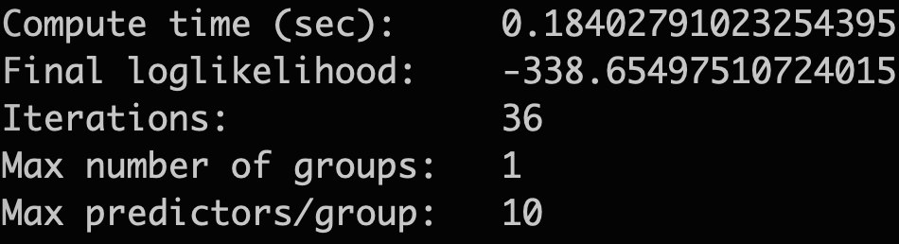
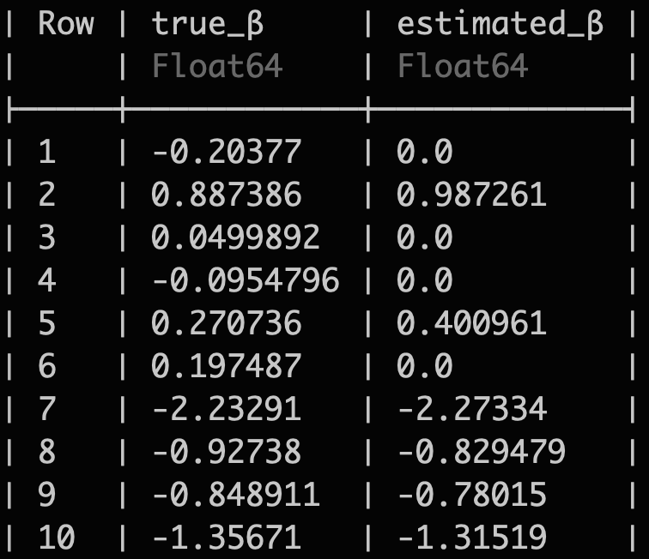
Example: Logistic regression (cont.)
Unbiased parameter estimates

Slide 7
Recall: MendelIHT is designed for GWAS
Memory management is key in bioinformatics.
can have samples and covariates.
Largest problem: 80 TB (Float64)
Medium problem: 400 GB (Float64)
Small problem: 12 GB (Float64)
Difficult even with cloud/cluster resources.
Solution: invoke SnpArrays.jl for compressed linear algebra routines.

Slide 8
Fast Linear Algebra with Compressed Data
Since , we store as 2 bitarrays.
Less vulnerable to data swapping with the hard disk.
Faster than BLAS even without multi-threading
Matrix Size | BLAS (multithreaded) | SnpArrays (single thread) | # of Times Faster
1.2 GB | 0.080 s | 0.663 s | 0.12
12 GB | 3.966 s | 5.612 s | 0.71
24 GB | 57.073 s | 11.227 s | 5.08
48 GB | 175.689 s | 26.540 s | 6.62
Matrix-vector multiplication benchmarked on 2019 macbook pro with
16GB of RAM, equipped with 8 cores, each are 9th generation i9, 2.3 GHz CPUs

Slide 9
Conclusions
IHT is better than lasso and marginal tests
MendelIHT works for generalized linear model regression problems
MendelIHT is especially powerful for GWAS due to memory savings from compressed storage

Slide 10
Acknowledgements
JuliaCon 2019 for Travel Assistence
Google Summer of Code 2018
NIH T32-HG002536 (GATP) training grant
References
Package: github.com/biona001/MendelIHT.jl
Chu et al. Multivariate GWAS, Generalized Linear Models, Prior Weights, and Double Sparsity. BioRxiv Preprint: 10.1101/697755
Keys et al. Iterative hard thresholding for model selection in genome-wide association studies. Genetic Epidemiology 2017;41:756–768.
Zhou et al. OpenMendel: a cooperative programming project for statistical genetics. Human Genetics 2019;p. 1–11.

